Slide 1
Generic Clinical Reminders developed using GELLO VA Innovation Project #209
Medical-Objects

Slide 2
Goals
Demonstrate the usefulness of Gello and VMR as a platform for the development of clinical reminder logic.
Demonstrate the use of Gello within the context of Arden Syntax “curley braces” {} for providing access to clinical information, and clinical conclusions.
Demonstrate usefulness within VA MDWS/Vista data

Slide 3
Medical-Objects Gello Technology
Prior to the project Medical-Objects had developed a number of Gello related technologies useful to the purposes of the goals of this project.
This includes a number of things, those useful to the project being:
Gello Development Integrated Development Environment (IDE)
Code completion
Gello code execution and debugging tools
Model Explorer, Data Explorer
ISO 21090 Datatypes
Example VMRs
Terminology Services (including Snomed-CT subsumption)
Gello measures physical quantity unit conversions

Slide 4
Remote Gello Execution
CLIENT
S
Medical-Objects Gello IDE (Mowgli)
Gello Wizards
Gello Remote Engine
Medexter Arden Engine
Arden Gello Client
GELLO
In JSON
GELLO
Results
GELLO
In JSON
GELLO
Results
SERVER
HTTP Server
Terminology Service
SNOMED-CT
Gello REST Services
Gello Engine
Gello Runtime VM
Gello Core
Gello Measures
Gello ISO21090 Data types
VA Gello Extension
VA VMR
VA Taxonomy
NHIN to SNOMED-CT & LOINC Terminology Map
VA Measure Units
MDWS VMR Cache
MDWS EMR Service Client
NHIN XML Interface
LOINC
Subsumption queries
DATA
MDWS
VistA instance 2
VistA instance 1
VistA instance 3

Slide 5
Gello Development System
Gello Engine
Gello Core
Gello ISO21090 datatypes
VA Gello Extension
SNOMED-CT Subsumption Engine
VA Measure Units
Gello Runtime VM
Gello Measures
MDWS EMR Service Client
VA VMR
VA Taxonomy
MDWS VMR Cache
NHIN to SNOMED-CT & LOINC Terminology Map
NHIN XML Interface
Medical-Objects Gello IDE
Gello Wizards
Gello Remote Engine

Slide 6
Gello VA Extension
Purpose: Provide specific capabilities to enable Gello to run against data stored in VA Vista instances via MDWS webservices.
Source code can be compiled separate from Gello system as a loadable Gello plug-in.
VA Gello Extension
VA VMR
MDWS VMR Cache
NHIN XML Interface
VA Taxonomy
NHIN to SNOMED-CT & LOINC Terminology Map
VA Measure Units
MDWS EMR Service

Slide 7
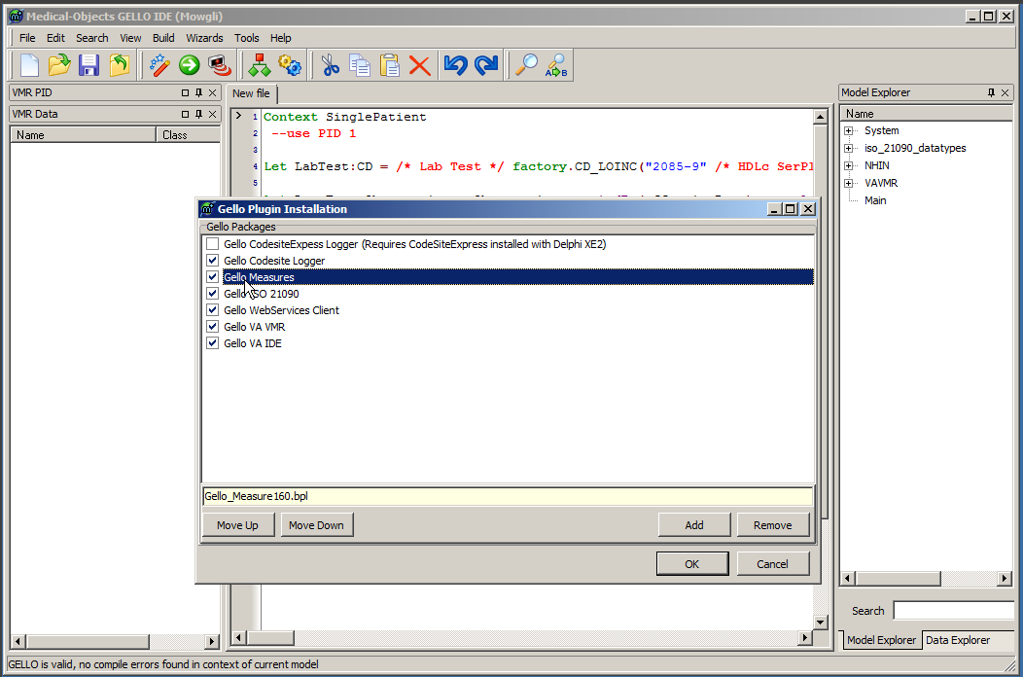
Gello Plugin Manager

Slide 8
Gello Measure Plugin
Base SI units and unit conversions

Slide 9
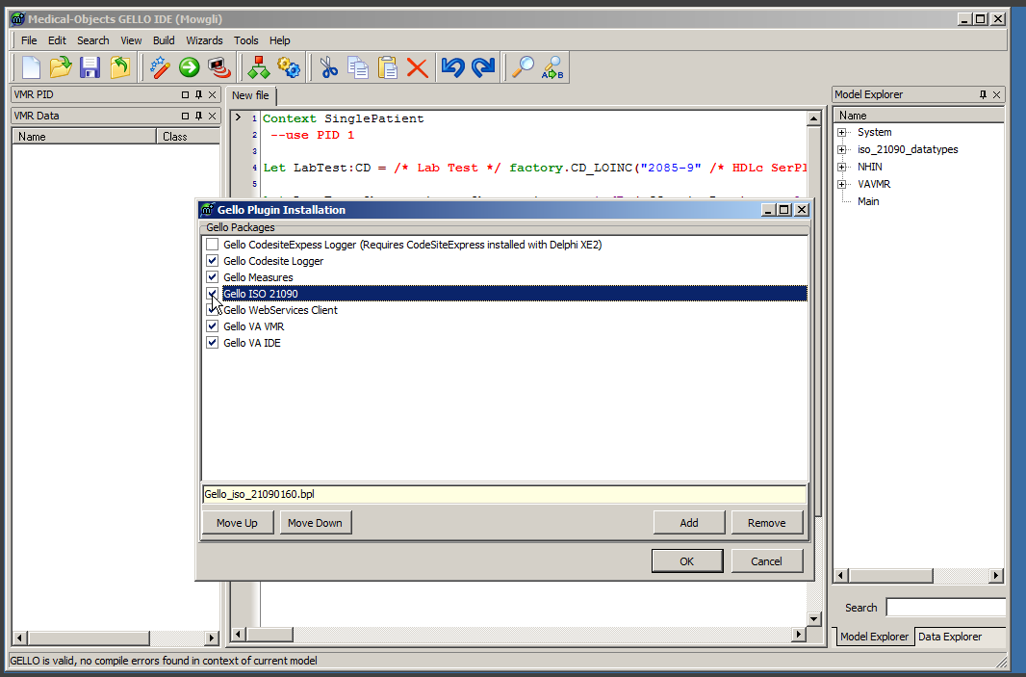
ISO 21090 Plugin
ISO Data types Gello Package
Implements class operations, such as PQ convert. Requires Gello Measures plugin.
TS comparisons operators

Slide 10
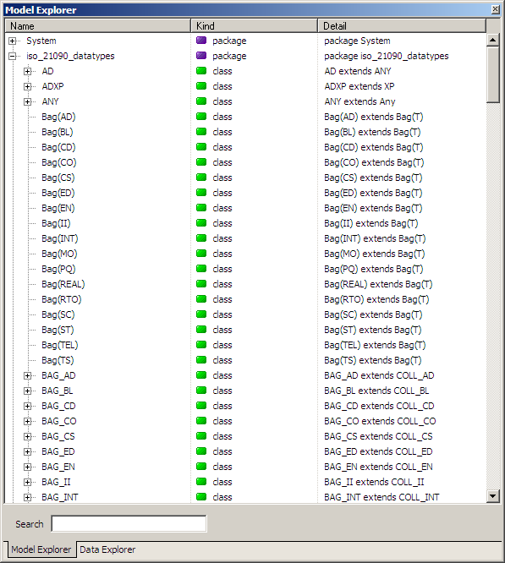
ISO 21090 Package

Slide 11
ISO 21090 Physical Quantity (PQ) Operations and attributes

Slide 12
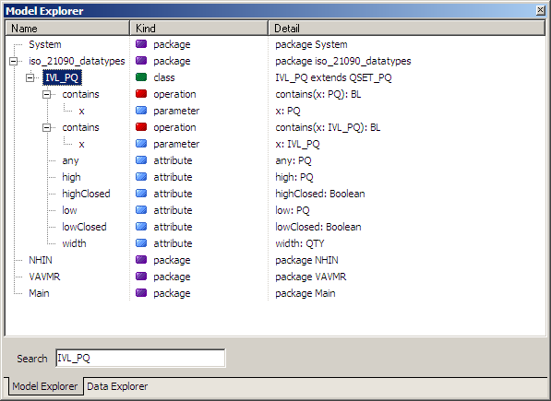
ISO 21090 – Interval Physical Quantity IVL_PQ

Slide 13
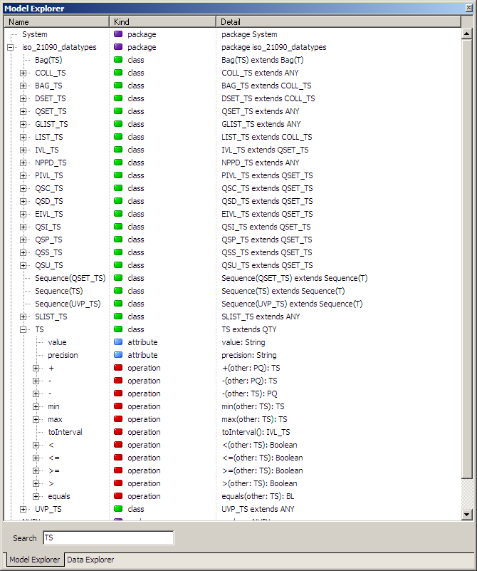
ISO 21090 – Time Stamp (TS) Attributes and Operations

Slide 14
VA VMR
The VA VMR is a Gello Package which uses the Gello ISO 21090 Datatypes to build a VMR to represent data VA accessed by using MDWS EmrSvc:getNhinData() call.
MDWS EmrSvc:getNhinData() returns XML which we call NhinData XML.
Gello ISO 21090 classes have operations to make working with clinical data easier, and provides a standard way of representing basic data

Slide 15
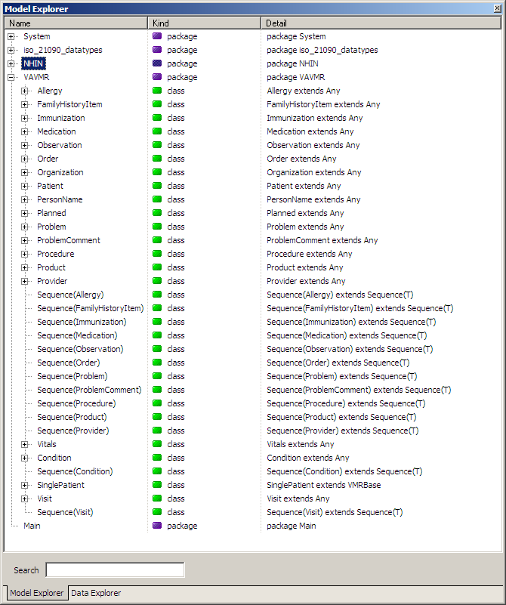
VA VMR Plugin
Provides 2 Packages
NHIN::
raw data from VISTA
VAVMR
Transformed into desirable VMR model
uses ISO datatypes
Defines units of measure used within VA VMR data. Derived from base SI units.

Slide 16
VA Units of Measure extension

Slide 17
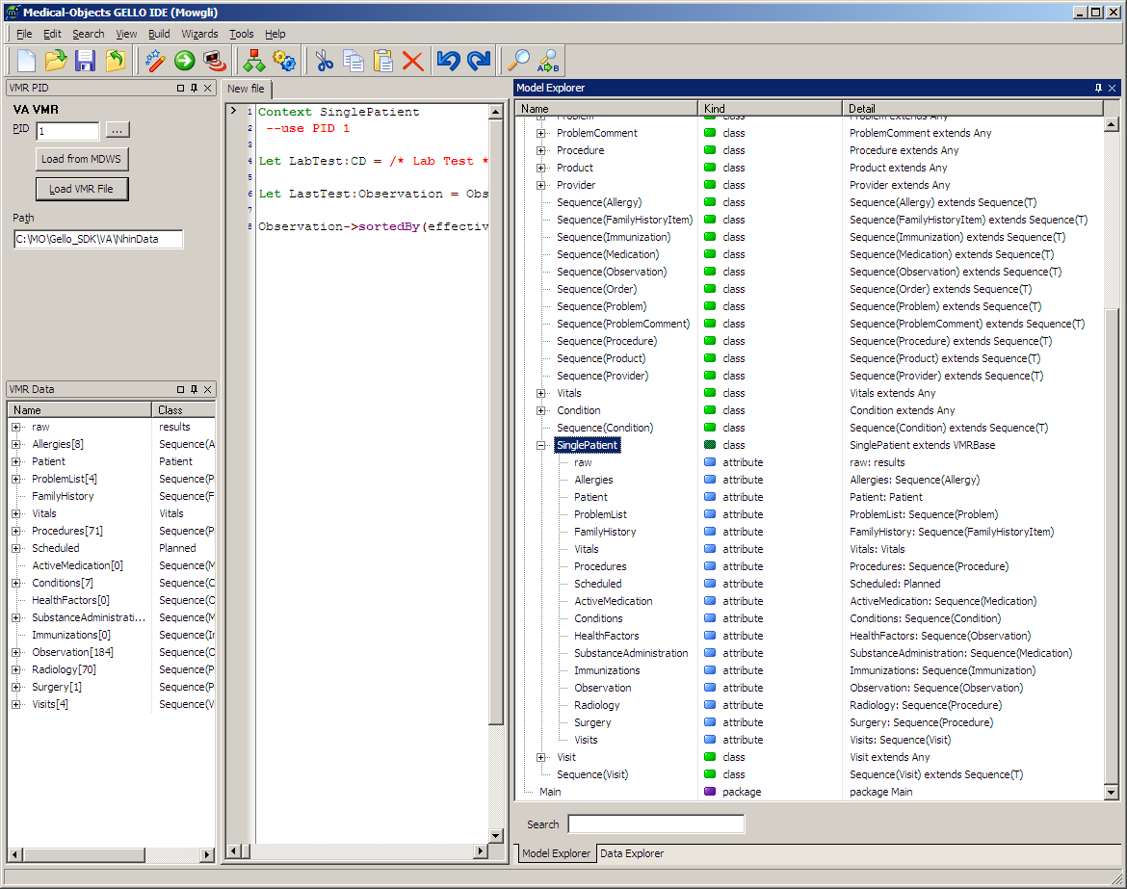
VAVMR::SinglePatient
Contains original raw NHIN data and collections

Slide 18
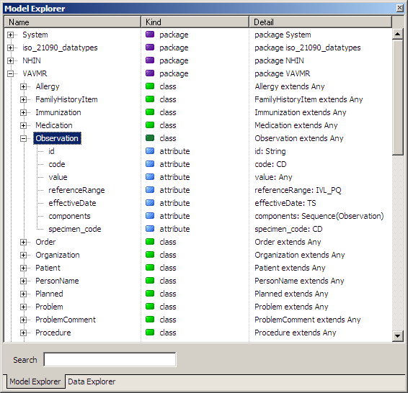
VAVMR::Observation
Uses ISO 21090 data types as attributes

Slide 19
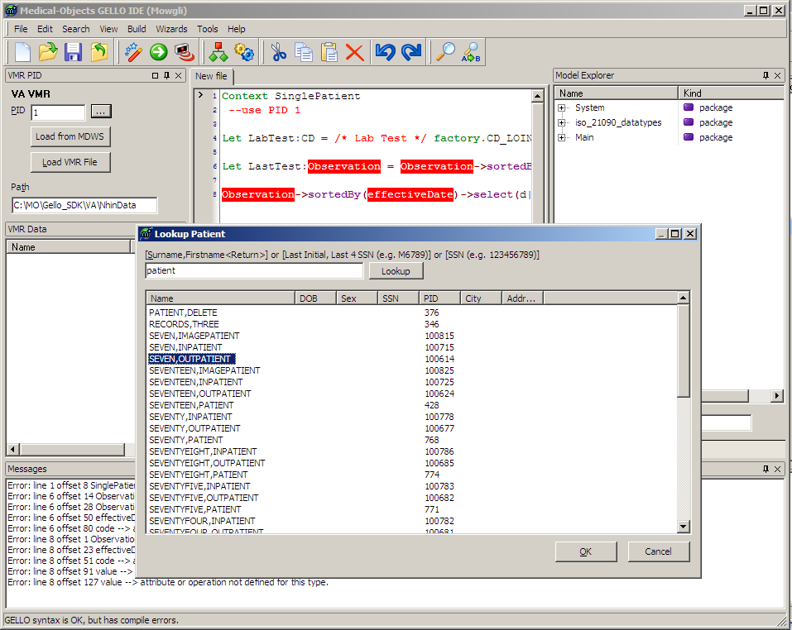
Retrieve Vista Patient data
Allows lookup of a patient from VistA via MDWS webservice

Slide 20
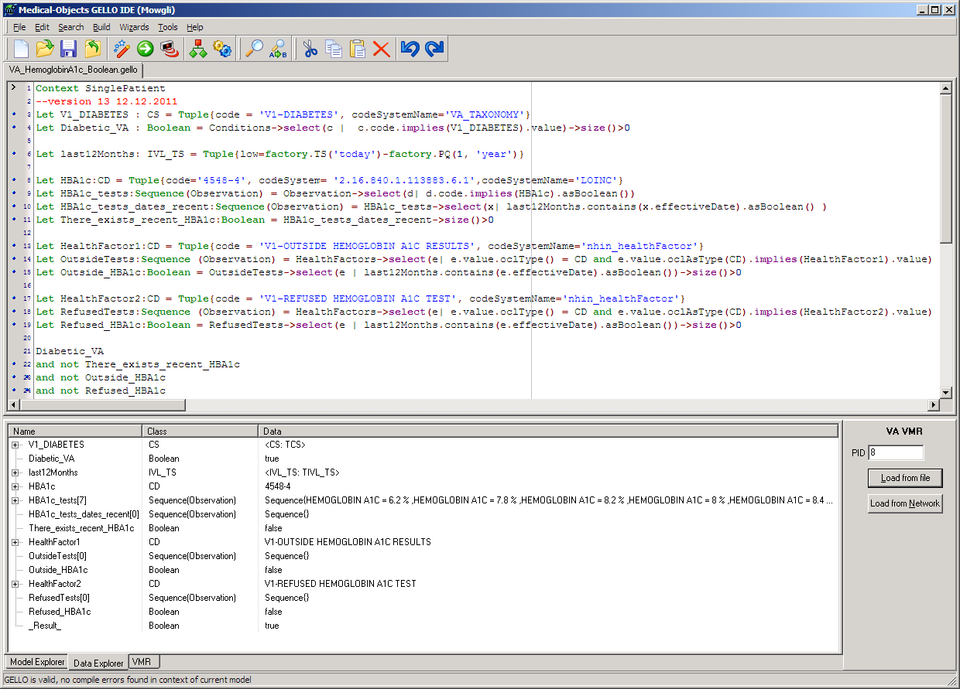
Clinical Reminder Tells if the patient should be prompted for a HBA1c. How good or bad Diabetes control. Looking for people who have diabetes who haven’t hada HBA1c but should have one done.

Slide 21
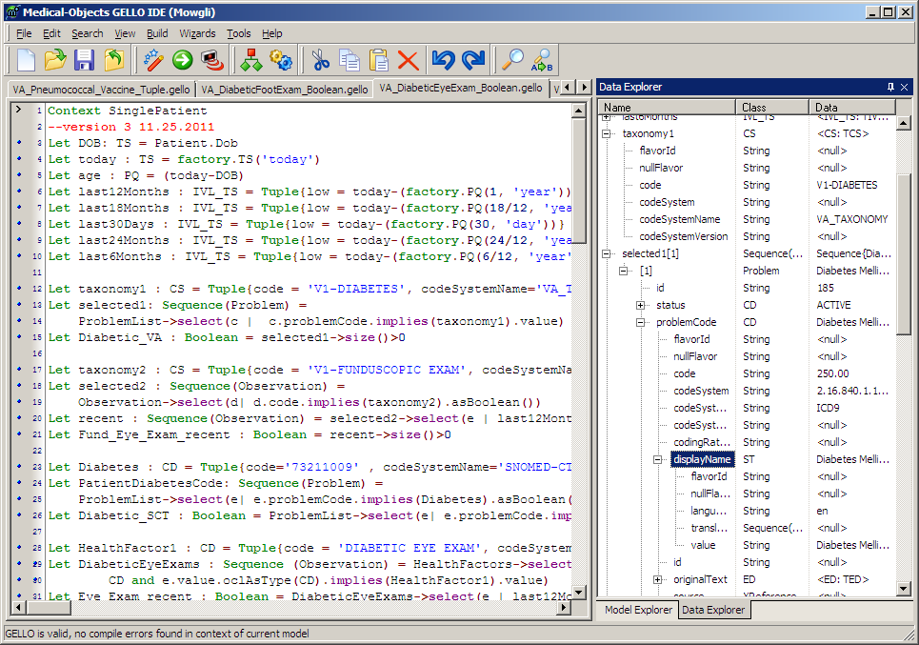
Diabetic Eye Exam Example

Slide 22
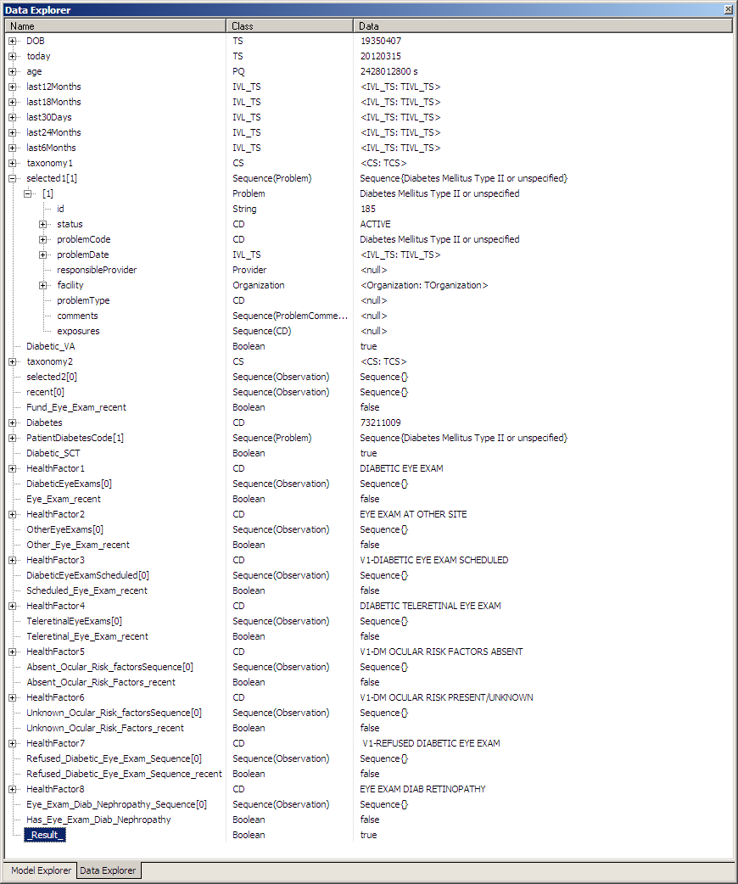

Slide 23
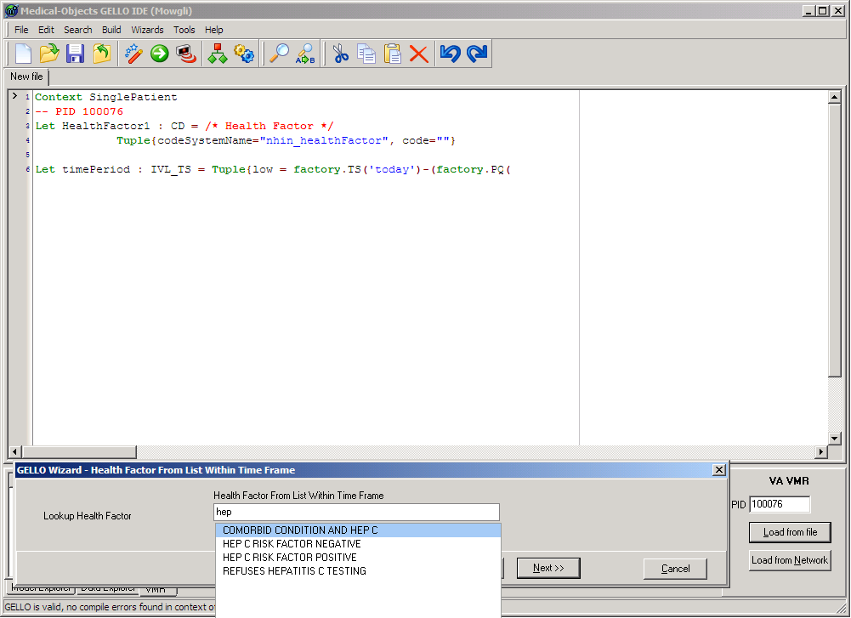
Gello Wizard
Assists a novice by writing Gello code. In this case to select certain health factors.

Slide 24
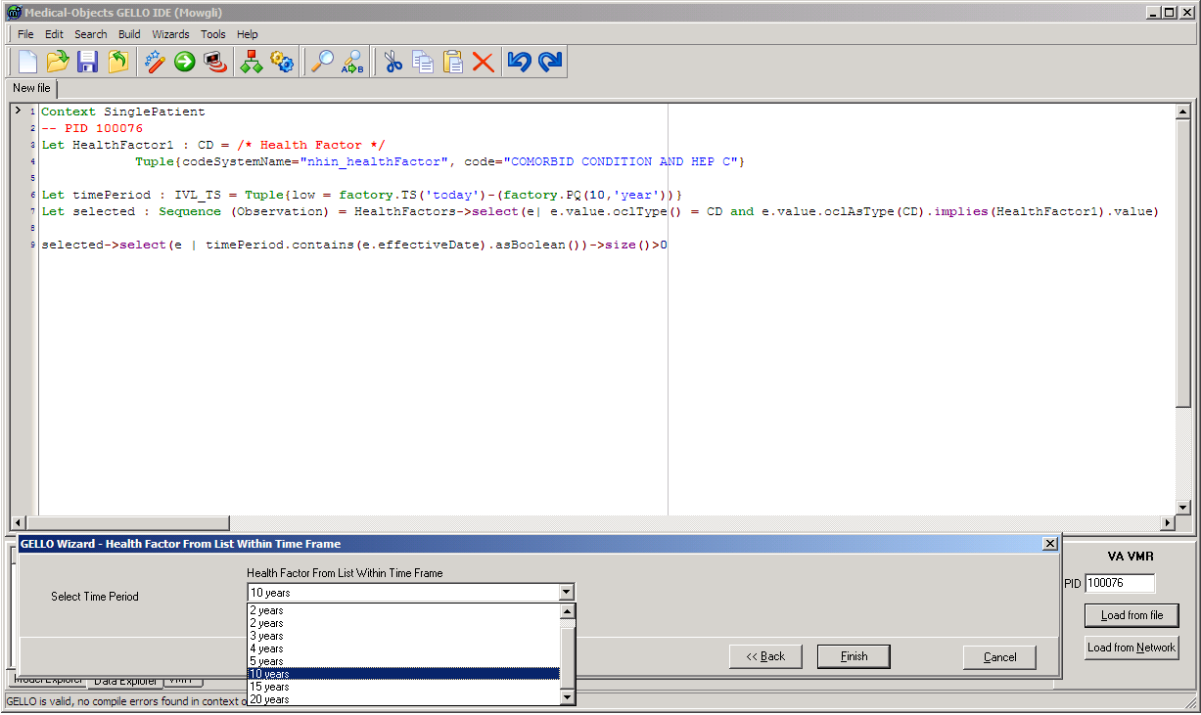
Gello Wizard
Further select results according to a recent time period

Slide 25
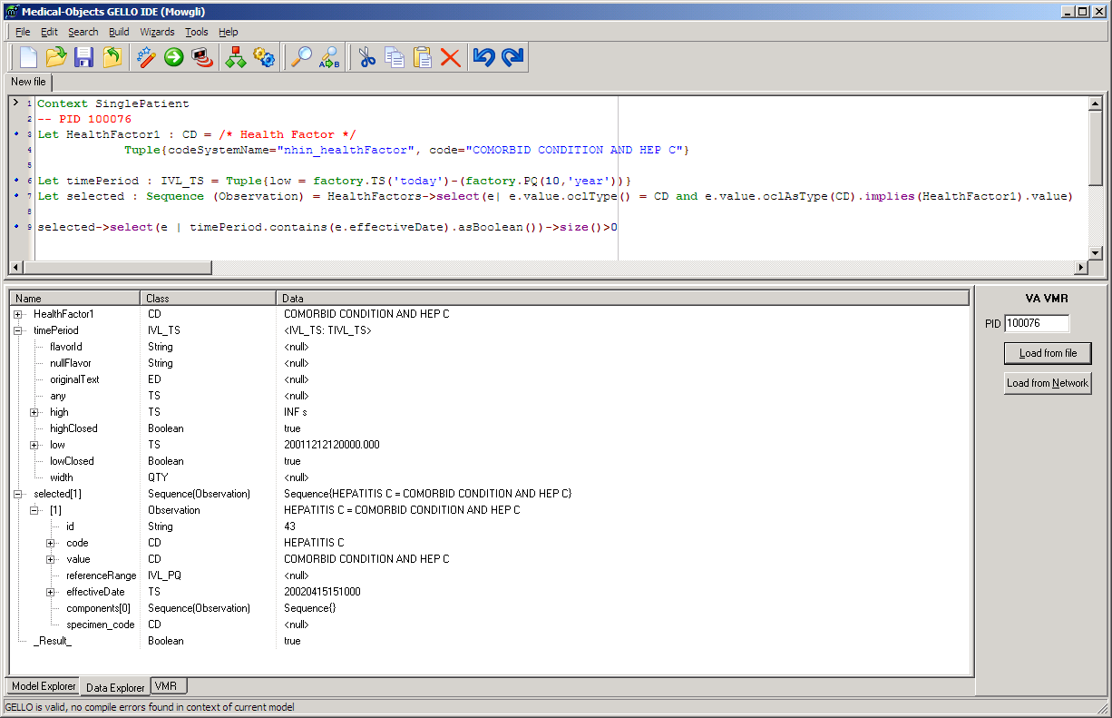
Gello Wizard
Completed Gello wizard, has generated gello code that can be run.

Slide 26
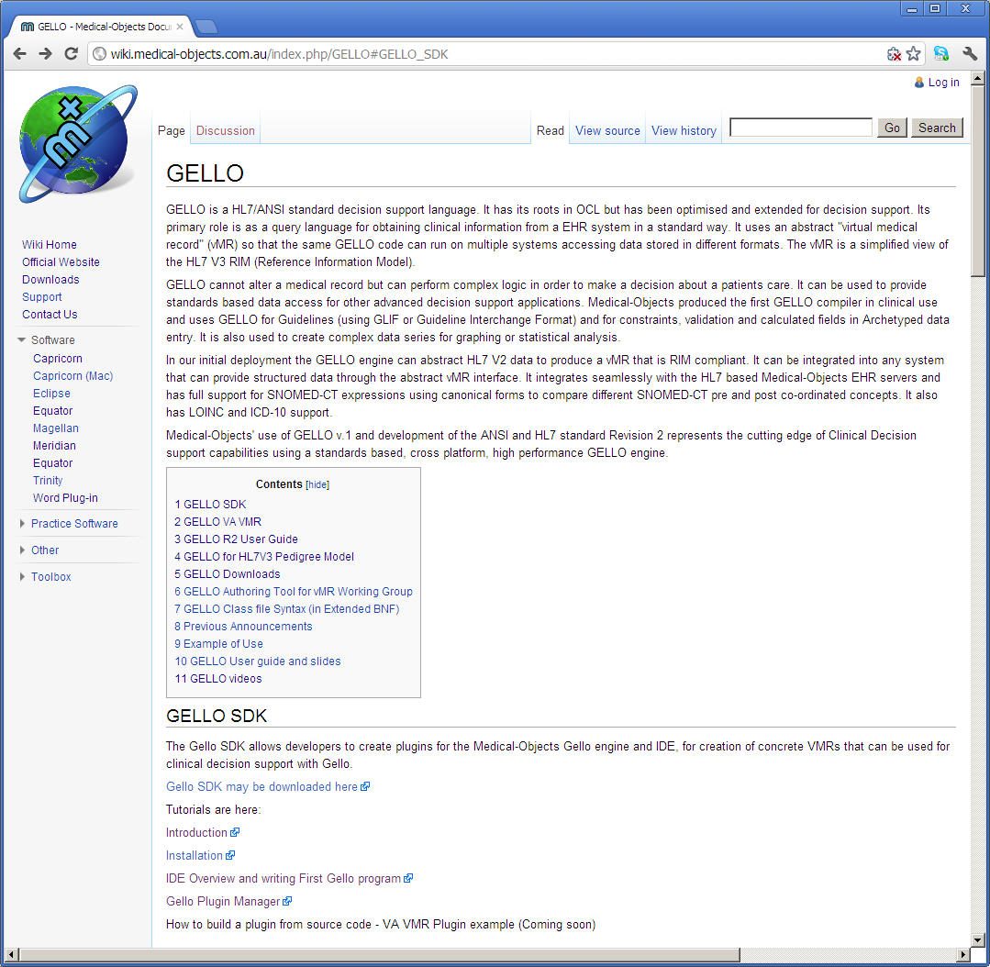

Slide 27
Demonstration Gello Software
http://wiki.medical-objects.com.au/index.php/GELLO#GELLO_SDK
Includes clinical reminder Gello and xml nhin test patient data retrieved from MDWS getNhinData().
The Gello SDK is plug-able and contains the Gello VA VMR, ISO21090 Extensions.
Video tutorials are available on the above wiki link.

